Slide 1
Graph and Trees

Slide 2
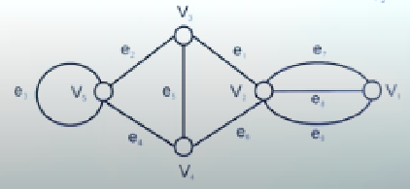
Graph
A graph G is mathematical structure consisting of two sets V and E
Where V is non empty set of vertices and E is non empty set of edges
Example
v₁
e₁
v₂
e₁
v₂
v₁
e₅
v₅
e₂
e₄
v₃
v₄
e₆
e₃

Slide 3
Basic Terminology
Trivial Graph
A graph consisting only one vertex and no edge
Example
Null Graph
A graph consisting n vertices and no edges
Example

Slide 4
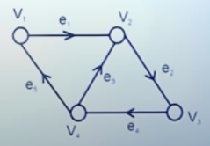
Basic Terminology
Directed Graph
A graph consist the direction of edges then this is called directed graph
Example
Undirected Graph
A graph which is not directed this is called undirected graph

Slide 5
Basic Terminology
Self loop in a Graph
If edge having the same vertex as both its end vertex is called self loop
Example
e₁
v₁
v₁
e₁
e₃
e₄
v₂
v₃
e₂

Slide 6
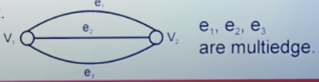
Basic Terminology
Proper edge
An edge which is not self loop is called proper edge
Multi edge
A collection of two or more edges having identical end point
example

Slide 7
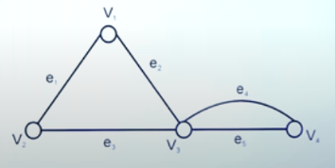
Basic Terminology
Simple Graph
A graph does not contain any self loop and multiedge
Multigraph
A graph does not contain any self loop but contain multiedge is called multigraph
example

Slide 8
Basic Terminology
Pseudo Graph
A graph contain both self loop and multedge is called pseudo graph
e₇
e₁
v₂
v₁
e₅
v₅
e₂
e₄
v₃
v₄
e₆
e₃
e₈

Slide 9
Basic Terminology
Incidence and adjacency
Let e_{k} be an edge joining two vertices V_{i} and V_{j} then e_{k} is said to be incident of V_{i} and V_{j}
Two vertices are said to be adjacent if there exist an edge joining this vertices
Example
Here e₁ is incident of V₁ and V₂ and
V₁ and V₂ are adjacent but V₁ and V₃
are not adjacent for e₁
v₁
e₃
e₁
v₂
v₃
e₂

Slide 10
Basic Terminology
Degree of vertex
The degree of vertex V in a graph G written as d(V) is equal to number of edges which are incident of V with self loop count twice
Example
d(V₁)=4
d(V₂)=2
d(V₃)=2
d(V₄)=3
d(V₅)=2
d(V₆)=2
d(V₇)=1
d(V₈)=0
e₈
v₁
v₇
e₁
e₄
e₇
v₂
v₄
v₆
v₈
e₅
e₂
e₃
e₆
v₃
v₅

Slide 11
Basic Terminology
Isolated vertex and pendant vertex
A vertex having degree 0 is called isolated vertex and a vertex having degree 1 is called pendant vertex

Slide 12
Basic Terminology
Finite and infinite graph
A graph with a finite number of vertices as well as edge is called finite graph otherwise it is an infinite graph
Example
v₅
v₁
v₄
v₂
v₃

Slide 13
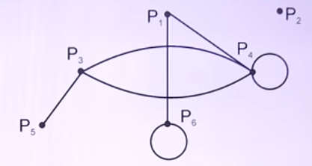
Which of the following is true for given graph
deg (p₆) = 3
deg (p₆) = 2
deg (p₁) = 2
deg (p₂) = 1
A
B
C
D

Slide 14
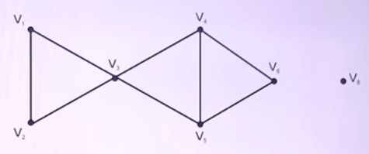
Number of isolated vertex in following graph is
A
0
B
1
C
2
D
4

Slide 15
Which of the following is pseudo graph
v₁
A
v₃
v₄
v₂
v₁
B
v₁
v₃
C
v₃
v₂
v₄
v₂
D
None of these

Slide 16
Draw a graph for the following data
If V = {v₁, v₂, v₃, v₄, v₅}
E = {(v₁, v₄), (v₂, v₃), (v₃, v₄), (v₄, v₅)}
f : V {Pakistani cities}
g : E N,
f(v₁) = Islamabad, g((v₁, v₄)) = 200
f(v₂) = Peshawar, g((v₂, v₃)) = 350
f(v₃) = Karachi, g((v₃, v₄)) = 500
f(v₄) = Lahore, g((v₄, v₅)) = 80
f(v₅) = Multan
Then to label after drawing the diagrams of the graph

Slide 17
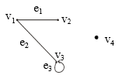
EXAMPLE:
Define the following graph formally by specifying its vertex set, its edge set, and a table giving the edge endpoint function.
SOLUTION:
Vertex Set = {v₁, v₂, v₃, v₄}
Edge Set = {e₁, e₂, e₃}
Edge - endpoint function is:
Edge | Endpoint
e₁ | {v₁, v₂}
e₂ | {v₁, v₃}
e₃ | {v₃}

Slide 18
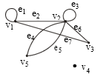
EXAMPLE:
For the graph shown below
(i) find all edges that are incident on v₁;
(ii)find all vertices that are adjacent to v₃;
(iii)find all loops;
(iv)find all parallel edges;
(v)find all isolated vertices;

Slide 19
SOLUTION:
v₁ is incident with edges e₁, e₂ and e₇
vertices adjacent to v₃ are v₁ and v₂
loops are e₁ and e₃
only edges e₄ and e₅ are parallel
The only isolated vertex is v₄ in this Graph.

Slide 20
DRAWING PICTURE FOR A GRAPH:
Draw picture of Graph H having vertex set {v₁, v₂, v₃, v₄, v₅} and edge set {e₁, e₂, e₃, e₄} with edge endpoint function
Edge | Endpoint
e₁ | {v₁}
e₂ | {v₂,v₃}
e₃ | {v₂,v₃}
e₄ | {v₁,v₅}

Slide 21
DRAWING PICTURE FOR A GRAPH:
SOLUTION:
Given V(H) = {v₁, v₂, v₃, v₄, v₅}
and E(H) = {e₁, e₂, e₃, e₄}
with edge endpoint function
v₁
e₄
e₁
v₂
e₂
v₅
e₃
v₃
v₄

Slide 22
TREE AND ITS PROPERTIES

Slide 23
Tree
A tree is a connected graph without any loop or circuits
Example

Slide 24
ROOTED TREE
A rooted tree is a tree in which one vertex is root
Example

Slide 25
BINARY TREE
A binary tree is defined as a tree in which there is exactly one vertex of degree two, and each of remaining vertices is of degree one or three and vertex of degree two is serves as a root
Example
It is not a binary
tree

Slide 26
PENDENT VERTEX TREE
A vertex of degree one is called pendent vertex of tree
Example
u
v
w
x
z

Slide 27
PATH LENGTH OFTREE
A path length of a tree is defined as the sum of edges from the root of all pendent vertices
Example
The path length =
2+2+2+3+3=12

Slide 28
SPANNING TREE
If G is any connected graph a spanning tree in G is a subgroup T of G, which is tree.
Example

Slide 29
Draw a complete graph of four vertices and find spanning tree in this graph

Slide 30
Show that there is only one path between every pair of vertices in a tree T
PROOF:
Suppose that there are two path between vertices u and v then the union of these two path will contain a circuit
So, T cannot be tree.
Hence there is only one path between every pair of vertices in tree T

Slide 31
Prove that a tree with n-vertices (n – 1) edges
PROOF:
We proof this theorem by mathematical induction
(i) if n = 1, then no edge
(ii) if n = 2, then one edge
(iii) if n = 3, then 2 edges
So, by mathematical induction this theorem is hold for all trees with n vertices

Slide 32
FIND THE PATH LENGTH OF THE GIVEN TREE

